Slide 1
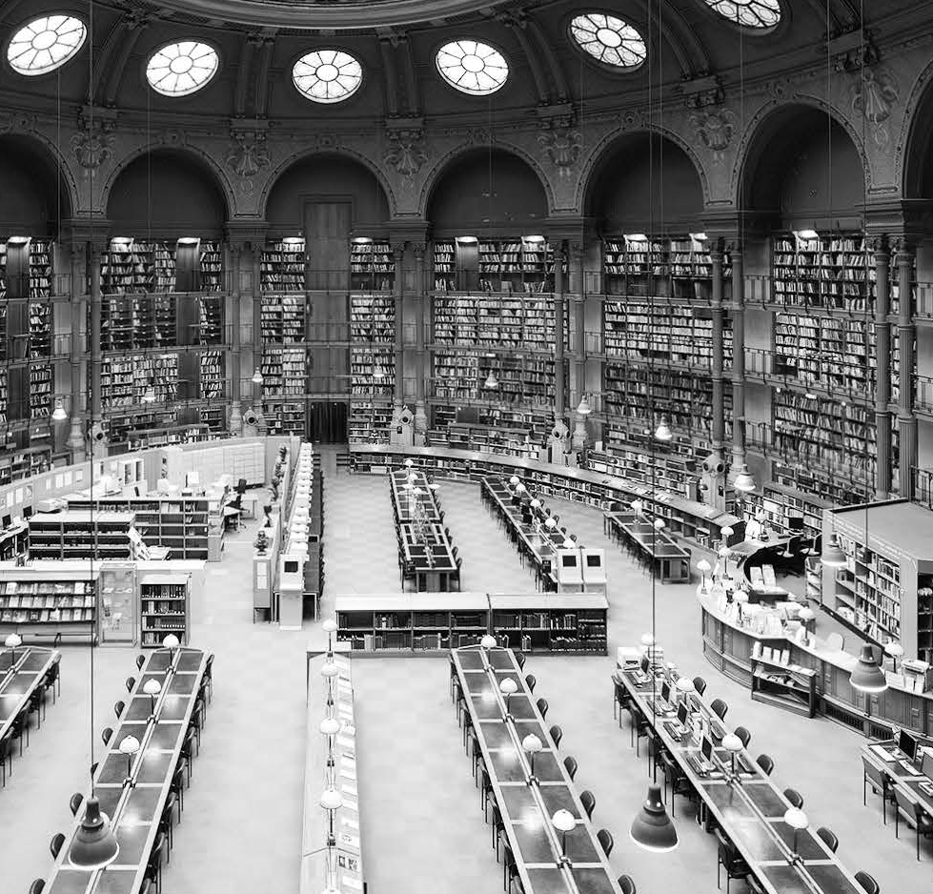
Unit 4
Globalization

Slide 2

Objectives
Academic Reading: Summarize the main ideas of a text and identify essential supporting points
Academic Viewing: Take notes in proper forms
Academic Speaking: perpare a strong opening
Academic Writing: Macro structures: write an introduction; Micro skills: write thesis statement

Slide 3
Contents
Reading
Viewing
Speaking
Writing

Slide 4

Reading
Text A
Globalization: the Good, the Bad and the Uncertain
Lead-in task
While reading
After reading tasks

Slide 5


Slide 6
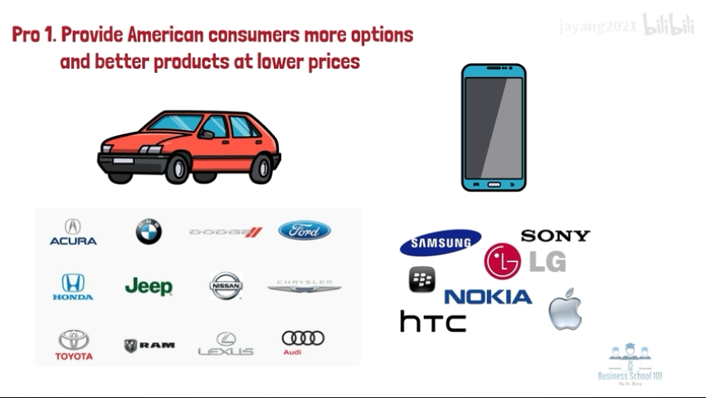

Slide 7
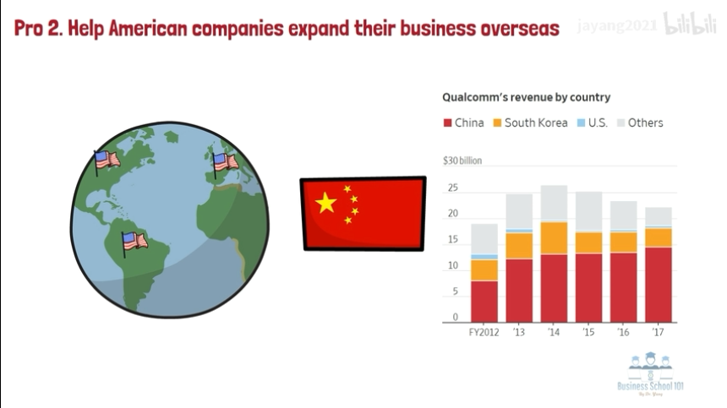

Slide 8
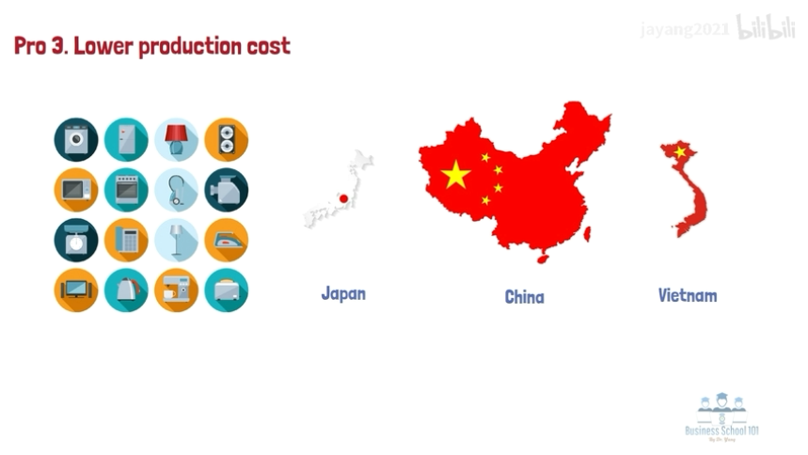

Slide 9
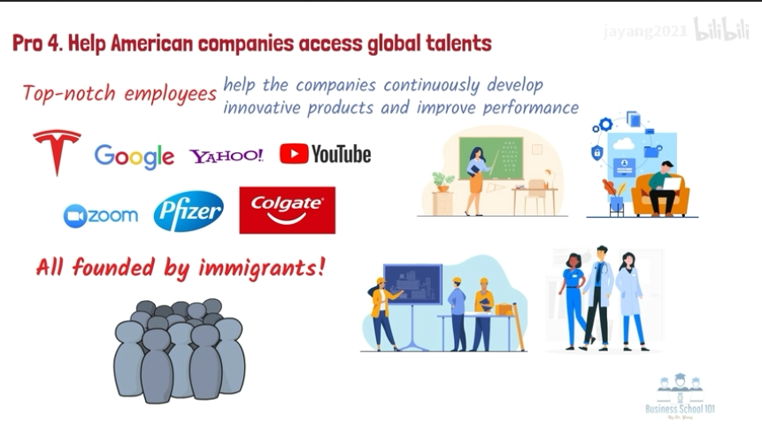

Slide 10
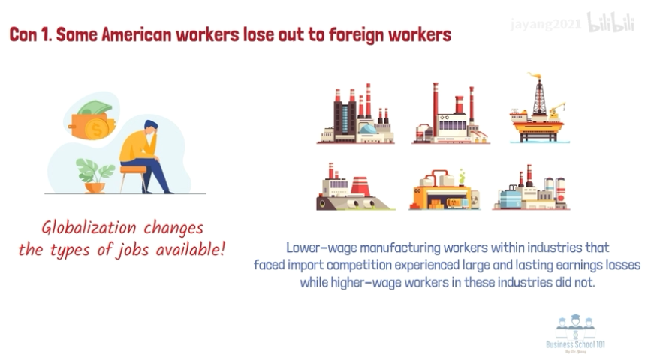

Slide 11
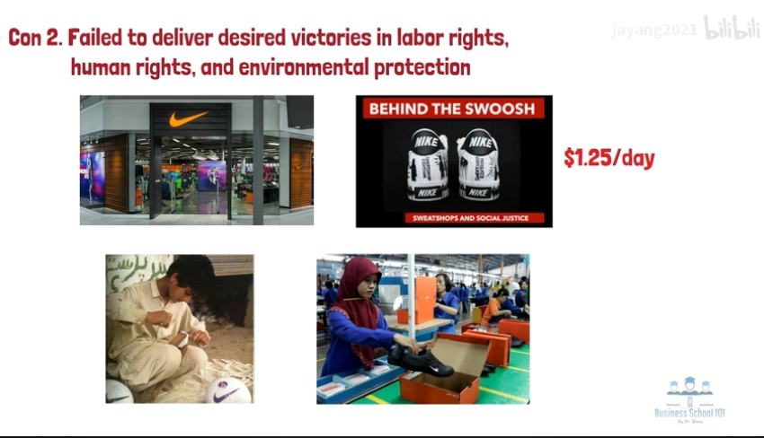

Slide 12
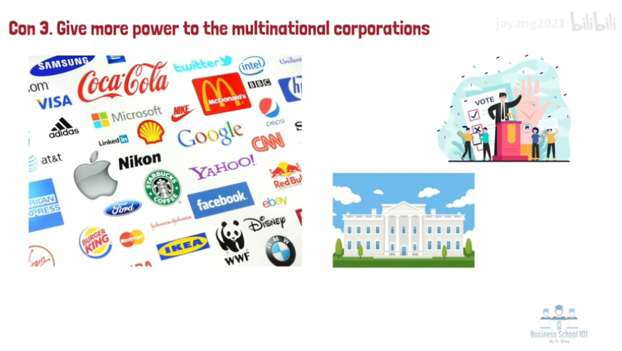

Slide 13
Text A Lead-in
task
Critical thinking
Write down pros and cons of globalization and then share your ideas with your partner.
 | Pros | Cons
1
2

Slide 14
Text A Lead-in
task
Critical thinking
Reference answers
Pros | Cons
more employment opportunities
increased access to education
enhanced product quality
cheaper prices
free movement of capital
easier communication with others
increased risk of the spread
of diseases
negative impacts on native
culture
uneven wealth distribution
environment degradation
cut-throat competition
monopoly

Slide 15
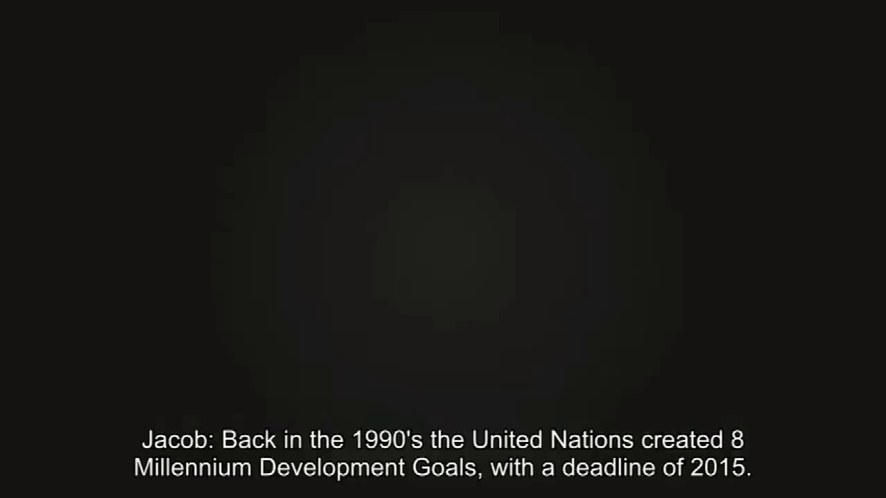

Slide 16
Text A While reading
The focused issue
globalization
Reading task
What are the impacts of globalization?

Slide 17
Text A While reading
Supplementary Information
1. global integration 全球一体化
Global integration is the process by which a company combines different activities around the world so that they operate using the same products and methods. Global integration can involve the processes of product standardization and technology development centralization, etc.

Slide 18
Text A While reading
Supplementary Information
2. protectionism 贸易保护主义
Protectionism is the economic policy of protecting domestic industries against foreign competition by restricting imports from other countries through methods such as tariffs on imported goods, import quotas and a variety of other government regulations. Protectionists believe that allowing foreign goods to enter domestic markets without being subject to tariffs or other forms of taxation, leads to a situation where domestic goods are at a disadvantage.

Slide 19
Text A While reading
Supplementary Information
3. xenophobia 排外
Xenophobia is the fear or hatred of that which is perceived to be foreign or strange. It typically involves the belief that there is a conflict between an individual’s ingroup and an outgroup. It may manifest in suspicion of the other’s activities, a desire to eliminate their presence, and fear of losing national, ethnic or racial identity.

Slide 20
Text A While reading
Supplementary Information
4. nationalism 民族主义
Nationalism is an ideology by people who believe their nation is superior to all others. In most contexts today, nationalism is “the policy or doctrine of asserting the interests of one’s own nation viewed as separate from the interests of other nations or the common interests of all nations.”

Slide 21
Globalization: The Good, the Bad and the Uncertain
Text A
1
When over 2000 world leaders of government, business and academia descended on Davos last month, discussions were dominated by the global economic crisis, the deep trouble in the Eurozone, and issues of lending, jobs, income disparity and growth. But there is a deeper crisis that penetrates beneath these significant troubles of today. This is a period of crisis in globalization and in values—a very deep crisis. This is not just an economic issue, although that has been the surfaced manifestation at the present time. This is also about culture, values, connectivity, and many other dimensions.
Background

Slide 22
2 Globalization is at the centre of today’s debates. Yet, despite much research and commentary, vital dimensions remain poorly understood. Recent decades of globalization have created a more interconnected, interdependent and complex world than ever witnessed before. While global policy has focused on facilitating integration, the implications of growing interdependence have been largely ignored. The acceleration in global integration has brought many benefits, but it also has created fragility through increased vulnerability and exposure to global shocks, such as today’s financial crisis.
Research gap

Slide 23
Text A While reading
Language Support
Recent decades of globalization has created a more interconnected, interdependent, and complex world than ever witnessed before. (Para. 2)
more … than ever before: 比以往任何时候更加…
e.g. Society is now much more diverse than ever before.
It’s hoped that the telescope will enable scientists to see more about the universe than ever before.

Slide 24
Text A While reading
Language Support
The acceleration in global integration has brought many benefits, but it also has created fragility through increased vulnerability and exposure to global shocks, such as today’s financial crisis. (Para. 2)
Well beyond purely the financial arena, new systemic risks loom large in areas such as climate change, ... (Para. 5)
The phrase “such as” is used to signal examples. Giving examples is particularly important in academic writing, as examples are usually used as evidence to support general claims. In addition, examples help us understand difficult concepts. As a rule, examples usually come after general arguments or unfamiliar terms.

Slide 25
Text A While reading
Language Support
Below are other signal or clue words indicating that the author is giving examples:
For example, ...
A good example of this is ...
As an illustration, ...
To give you an example, ...
… is a case in point.

Slide 26
3 The biggest challenge for politicians and policy makers is the need to balance the enormous benefits that global openness and connectivity brings, with national politics and priorities. It also is a major concern for citizens, who are torn between the benefits of imported goods and services, and their worries about local jobs, the dangers associated with illicit flows, and other implications of more open borders. These concerns are universal and effect all countries.
Uncertainty:
double-edged sword

Slide 27
4 The benefits of global integration have been associated with unprecedented leaps in human development indicators. Technological innovation has accelerated integration both virtually, through the development of fibre optics, the internet and mobile telephony, as well as physically with vast improvements in transport and infrastructure. The spread of people, ideas, trade and the inspiring education revolution has and will continue to offer enormous potential for poverty alleviation and economic opportunity.
Pro1
Pro2

Slide 28
Text A While reading
Language Support
The spread of people, ideas, trade and the inspiring education revolution has and will continue to offer enormous potential for poverty alleviation and economic opportunity. (Para. 4)
has and will continue to: 已经并将继续
e.g. Bach’s music has and will continue to shape my life in years to come.
International understanding has and will continue to benefit through the Fellowship.

Slide 29
5 Yet the downside to globalization is that of increased inequality between and within countries. And the second “side-effect” is that the likelihood of increasing numbers of global shock and crises is growing, as is our vulnerability to them. Little is understood about the risks associated with large scale system interdependencies. Well beyond purely the financial arena, new systemic risks loom large in areas such as climate change, water and food insecurity, pandemics, resource scarcity, antibiotic resistance, bioterrorism, cyber security and supply chain vulnerability.
con 1
con 2
con 3

Slide 30
6 The fragility of the system as a result of these new vulnerabilities now challenges the very core of the benefits that globalization has produced and is a fundamental challenge to national governments, business leaders and global institutions. Unless we can find an appropriate balance, there is a significant risk that the failure to manage globalization will lead to a backlash of protectionism, xenophobia and nationalism. This crisis requires an extraordinarily deep level of reflection from global leaders, and society at large. To turn our backs on globalization would severely undermine economic growth, poverty reduction and global cooperation.
Uncertainty:
lack of sustainability

Slide 31
Text A While reading
Language Support
To turn our backs on globalization would severely undermine economic growth, poverty reduction, and global cooperation. (Para. 6)
turn sb.’s back (on sb. / sth.): to refuse to help, support, or be involved with sb. or sth.（对某人/某事）置之不理；（对某人/某事）撒手不管
e.g. I can’t turn my back on my own daughter, no matter what she has done.
One ought never to turn one’s back on a threatened danger and try to run away from it.

Slide 32
7 If the benefits of globalization are to continue to outweigh the risks that rapid integration exacerbates, understanding systemic interconnections and building multistakeholder responses are vital. Redesigning global risk governance mechanisms to take these interconnections into account and to enable cooperation is a major but necessary undertaking. The bad news is that the tidal wave of globalization has brought unprecedented and new systemic risks. The good news is that this phase of globalization has brought the means to meet the downsides, through raising levels of wealth and opportunity, and vitally increasing our collective knowledge and connectivity. The opportunities for cooperative solutions have never been greater, particularly if we are to address the major challenges of the 21st century.
What we need to do

Slide 33
8 Yet to harness these opportunities, we need an intellectual revolution. We need a citizens’ mobilisation, and we certainly need a fundamental leadership and institutional shift. Global leaders at Davos and beyond are right to worry about today’s significant economic woes. But we ignore the bigger crisis emerging at the core of globalization, and jump from one crisis management to the next, at our peril.
What we need to do

Slide 34
Text A While reading
Language Support
But we ignore the bigger crisis emerging at the core of globalization, and jump from one crisis management to the next, at our peril. (Para. 8)
(do sth.) at sb.’s peril: at the risk of serious danger 冒险（做某事）
e.g. The farm lobby in industrial countries is powerful and politicians ignore it at their peril.
Since the relationship-defined obligations are all based on mutual benefit, one violates them at one’s own peril.

Slide 35
Text A While reading
Critical reading and thinking
Task 1 / Overview
1 In Text A, the author discusses the issue of globalization in three aspects: The good, the bad, and the uncertain. Read the text and fill in the blanks in the table below.
Globalization
Crisis in globalization | While global policy has focused on facilitating _________, the implications of growing ______________ have been largely ignored.
The good of globalization | ____________________ has accelerated integration both virtually and physically. The spread of people, ideas, trade and the inspiring education revolution will continue to offer enormous potential for ____________________________________.
integration
interdependence
Technological innovation
poverty alleviation and economic opportunity

Slide 36
Text A While reading
Critical reading and thinking
Task 1 / Overview
inequality
The bad of globalization | increased ________ between and within countries; increasing numbers of _____________________; _______ the financial arena, new systemic risks looming large in areas such as _____________, water and food insecurity, _________, resource scarcity, antibiotic resistance, bioterrorism, ____________ and supply chain __________.
The uncertain of globalization | The biggest challenge: balance the enormous ________ that global openness and connectivity brings, with ________________________. Unless we can find an appropriate balance, there is a significant risk that the failure to __________________ will lead to a backlash of ___________, xenophobia and __________.
global shocks and crises
Beyond
climate change
pandemics
cyber security
vulnerability
benefits
national politics and priorities
manage globalization
protectionism
nationalism

Slide 37
Text A While reading
Critical reading and thinking
Task 1 / Overview
The author’s suggestion | We need: ____________________; a citizens’ ___________; a fundamental _________ and institutional shift.
an intellectual revolution
mobilization
leadership

Slide 38
Text A After reading tasks
Critical reading and thinking
Task 2 / Points for discussion
1 It also is a major concern for citizens, who are torn between the benefits of imported goods and services, and their worries about local jobs, the dangers associated with illicit flows, and other implications of more open borders. (Para.3)
Do you agree with the author? Are you worried about local jobs? Why or why not?

Slide 39
Text A After reading tasks
Critical reading and thinking
Task 2 / Points for discussion
Reference answers
1)
a. I agree with the author. On one hand, globalization provides citizens with more choices for goods and services. On the other hand, the clandestine dimensions of globalization may involve illicit cross-border flows of people, goods, money and information. Both the benefits and risks of globalization are noteworthy, which could make citizens indecisive about this issue.

Slide 40
Text A After reading tasks
Critical reading and thinking
Task 2 / Points for discussion
Reference answers
b. I don’t agree with the author. Citizens should be well aware of the possible risks of globalization, but they should also know that most of the risks can be handled. This phase of globalization has brought the means to meet the downsides, through raising levels of wealth and opportunity, and vitally increasing our collective knowledge and connectivity. The opportunities for cooperative solutions have never been greater, particularly if we are to address the major challenges of the
21st century.

Slide 41
Text A After reading tasks
Critical reading and thinking
Task 2 / Points for discussion
Reference answers
2) I’m a little worried about local jobs, but I also see some new opportunities. I consider this issue from two aspects:
i) Number of jobs
Economic globalization may first have an impact on the number of jobs available in the economy, and thus affect key macro-economic variables such as the unemployment rate and the employment-to-population ratio. Offshoring is a case in point. Closing an enterprise in country A to move it to country B where costs of production are lower may result in job losses in a particular economic activity of country A. It may also result in job gains for country A as a whole because of higher productivity
in the remaining enterprises, higher wages, and higher
consumption demand.

Slide 42
Text A After reading tasks
Critical reading and thinking
Task 2 / Points for discussion
Reference answers
ii) Structure of jobs
Economic globalization may also affect the structure of jobs, i.e. their distribution across economic activities. Jobs linked to certain economic activities may tend to disappear whereas jobs linked to other, maybe new activities, are created due to changing competitive advantages and patterns of specialization.

Slide 43
Text A After reading tasks
Critical reading and thinking
Task 2 / Points for discussion
2 To turn our backs on globalization would severely undermine economic growth, poverty reduction, and global cooperation. (Para. 6)
Do you agree with the author? Why or why not? Give examples to illustrate your opinion.

Slide 44
Text A After reading tasks
Critical reading and thinking
Task 2 / Points for discussion
Reference answers
I agree with the author. Globalization has helped raise incomes, rapidly develop economies and lift millions out of poverty. To turn our backs on it would cause the rise of nationalism and protectionism, and economic depression. For example, slowing or even reversing globalization would hit the manufacturing industry very hard. In the UK, nearly every major car plant has shut down due to the reverse globalization trend in some Western countries aroused by the rising nationalism and protectionism. This hurts the car factories in the UK badly, since they are dependent on sales and components from around the world. When both collapsed, there is nothing they can do about it but stop manufacturing.

Slide 45
Text A After reading tasks
Critical reading and thinking
Task 2 / Points for discussion
Reference answers
Some factories may have to lay off staff to cope with the impact of reverse globalization. Global cooperation would be undermined as well. With the help of globalization, easier travel, trade deals, and new, rapidly developing economies have all combined to create a system that is much more dependent now on what is happening on the other side of the world than it ever was. Reverse globalization policies such as tariffs or other forms of taxation will put international organizations at a weaker position and create many obstacles for global cooperation.

Slide 46
Text A After reading tasks
Critical reading and thinking
Task 2 / Points for discussion
3 Is it a necessary undertaking to establish global risk governance mechanisms to cope with the global issues? Why or why not?

Slide 47
Text A After reading tasks
Critical reading and thinking
Task 2 / Points for discussion
Reference answers
I think it is a necessary undertaking to establish global risk governance mechanisms to cope with the global issues. The acceleration in global integration has brought many benefits, but it also has created fragility through the production of new kinds of systemic risks. A major explanation for such fragility lies in regulation deficiencies in economic, financial, and environmental fields, due to unaccountable, undemocratic, inequitable and ineffective global governance.

Slide 48
Text A After reading tasks
Critical reading and thinking
Task 2 / Points for discussion
Reference answers
The 2008–2009 financial crisis, for instance, illustrates the failure of global institutions to manage the underlying forces of systemic risk and keep pace with globalization. It highlights the urgency of the global risk governance. Thus, the whole world is in need of better global risk governance mechanisms, which will enable societies to benefit from change while minimizing the negative consequences of the associated risks.

Slide 49
Text A After reading tasks
Language building-up
Task 1 / Specialized vocabulary
1 Translate the following words and expressions from English into Chinese or vice versa.
economic crisis
1 经济危机 _______________________
2 收入分化 _______________________
3 全球政策 _______________________
4 全球一体化 _______________________
5 政策制定者 _______________________
income disparity
global policy
global integration
policymaker

Slide 50
Text A After reading tasks
Language building-up
Task 1 / Specialized vocabulary
减贫
6 poverty alleviation _______________________
7 global institution _______________________
8 protectionism _______________________
9 nationalism _______________________
10 global cooperation _______________________
11 risk governance mechanism____________________
全球性机构
贸易保护主义
民族主义
全球合作
风险治理机制

Slide 51
Text A After reading tasks
Language building-up
Task 1 / Specialized vocabulary
2 Complete the following sentences with the words or expressions from Exercise 1. Change the form where necessary.
1 The International Monetary Fund (国际货币基金组织) said this week that global growth would slow this year as levels of __________________ rise.
2 The statement said that __________________ is essential to deal with the health and economic impact of the COVID-19 virus.
3 The UN is a(n) __________________ that has done a lot in providing humanitarian assistance to affected regions in Africa.
4 A(n) __________________ is someone who creates ideas and plans, especially those carried out by a business or government.
protectionism
global cooperation
global institution
policymaker

Slide 52
Text A After reading tasks
Language building-up
Task 1 / Specialized vocabulary
5 Many older workers, generally those over 40, say they will need to work longer because of the __________________.
6 The study claims that up to 60 million people in Africa will be pushed into extreme poverty—that erases all the progress made in __________________ in the past three years.
7 __________________ is the degree to which total income is distributed unevenly throughout a population.
8 “If a vaccine is identified, production should be “globally distributed” to guard against “vaccine __________________,” she said.
economic crisis
poverty alleviation
Income disparity
nationalism

Slide 53
Text A After reading tasks
Language building-up
Task 2 / Academic vocabulary
Complete the following sentences with the words from the box. Change the form where necessary.
dominate | academia | dimension | integration | facilitate
implication | priority | mechanism | undertaking | cooperative
1 The new body is launched this month and will bring together experts from the government, the industry, and the ___________ to look at the challenge of funding energy industry research.
2 The story caught national attention, ___________ headlines and conversations across the country.
academia
dominating

Slide 54
Text A After reading tasks
Language building-up
Task 2 / Academic vocabulary
3 There are three main ___________ when it comes to globalization; they are economic, political, and cultural.
4 Dr. King’s dream of a peaceful ___________ between blacks and whites seemed to be fast fading away.
5 Employees’ health should be the No. 1 ___________ of the agencies, not scoring political points for rushing employees back.
6 The school system says they are acquiring more computers for students and teachers to ___________ remote learning.
dimensions
integration
priority
facilitate

Slide 55
Text A After reading tasks
Language building-up
Task 2 / Academic vocabulary
7 Oil prices are expected to decline further due to a slowdown in demand from the economic ___________ of the coronavirus.
8 The report shows that about 80% of the people are ___________ and wear masks.
9 For families in poor countries, sending a relative abroad to earn money tends to be a collective ___________.
10 The article says monetary compensation ___________ must be created to help developing countries.
implications
cooperative
undertaking
mechanisms

Slide 56
Text A After reading tasks
Language building-up
Task 3 / Collocations
Replace the underlined part in each of the following sentences with an expression from the box. Change the form where necessary.
loom large | at large | (do sth.) at sb.’s peril
associated with | turn your back on | at the core of
1 Millions of institutions now are relying on Tencent Meeting because of lockdowns connected with the coronavirus, the company said.
2 Negative equity is a distant memory for many, while pension deficits become prominent.
associated with
loom large

Slide 57
Text A After reading tasks
Language building-up
Task 3 / Collocations
3 Climate change and animal extinction are grave environmental warnings, which you ignore at the risk of serious danger.
_______________ 4 Race was always at the center of the divisions, and it soon became a weapon in political campaigns.
_______________ 5 She abandoned nine years of teaching and began the daunting task of learning a new profession.
6 The new dividend policy attracted virtually no attention from the world in general.
at your peril
at the core of
turned her back on
at large

Slide 58
Text A After reading tasks
Language building-up
Task 4 / Formal English
Replace the underlined words and expressions with more formal ones from Text A.
1 When over 2,000 world leaders of government, business and academia arrived at Davos unexpectedly last month, discussions were dominated by the global economic crisis, …
2 This is not just an economic issue, although that has been the surfaced sign at the present time.
____________ 3 This crisis requires an extremely deep level of reflection from global leaders, and society at large.
descended on
manifestation
extraordinarily

Slide 59
Text A After reading tasks
Language building-up
Task 4 / Formal English
4 To turn our backs on globalization would severely weaken economic growth, poverty reduction, and global cooperation.
5 If the benefits of globalization are to continue to be more important than the risks that rapid integration exacerbates, understanding systemic interconnections and building multi- stakeholder responses are vital.
6 The opportunities for cooperative solutions have never been greater, particularly if we are to deal with the major challenges of the 21st century.
undermine
outweigh
address

Slide 60
Text A After reading tasks
Language building-up
Task 4 / Formal English
____________ 7 Yet to control and use these opportunities, we need an intellectual revolution.
8 Global leaders at Davos and beyond are right to worry about today’s significant economic problems.
harness
woes

